Slide 1
Tokyo Neighborhoods

Slide 2

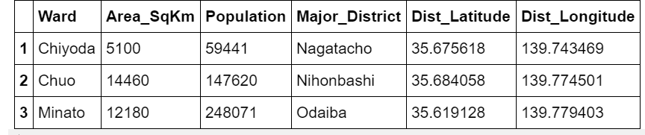
Tokyo
What kind of restaurant to open in Tokyo?
‘Wards of Tokyo’ data:

Slide 3
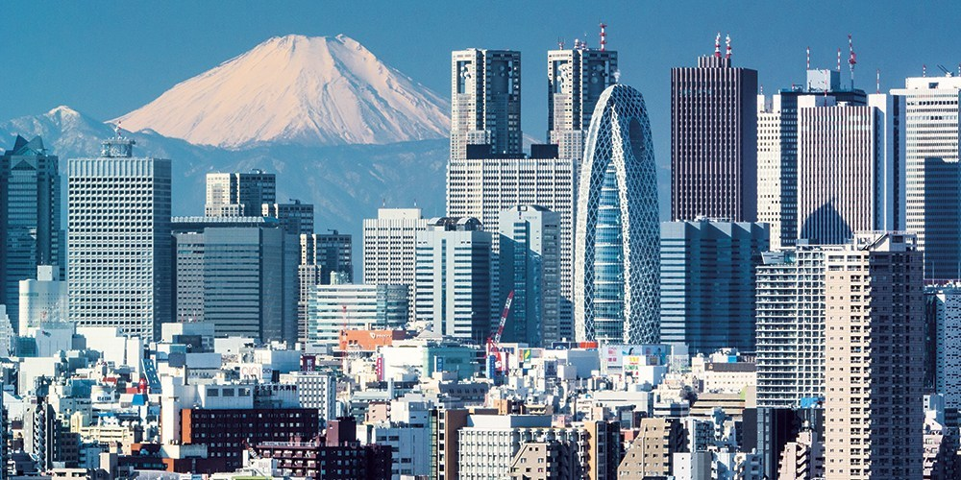
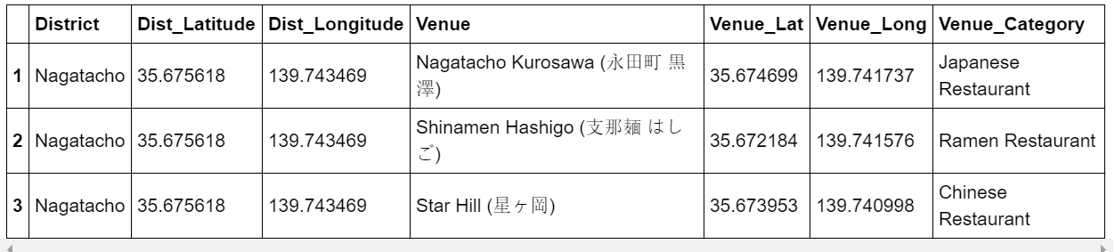
Find all the restourants in Tokyo major districts:

Slide 4
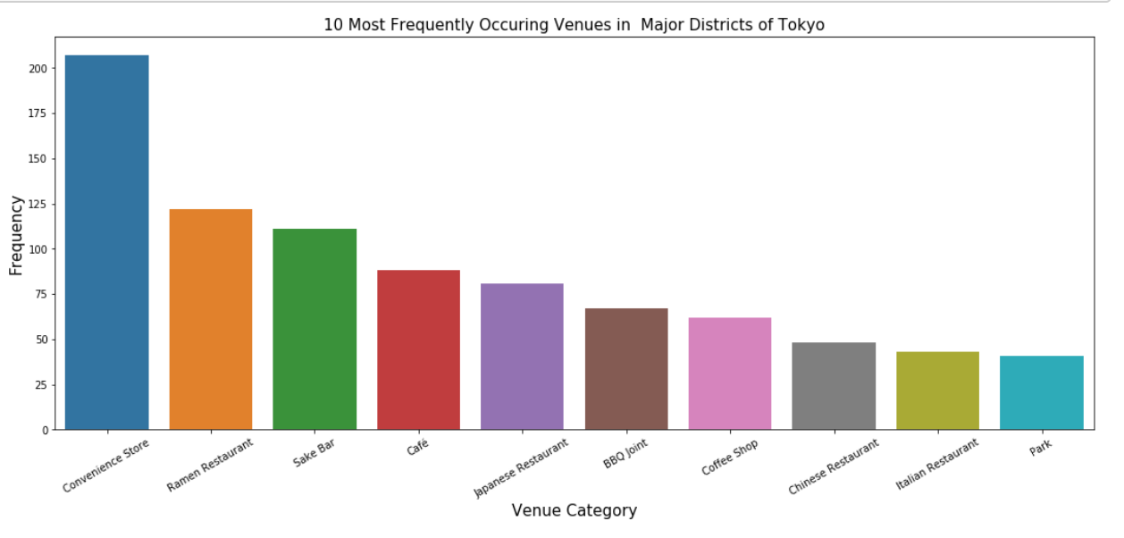
Which restaurants are popular?

Slide 5
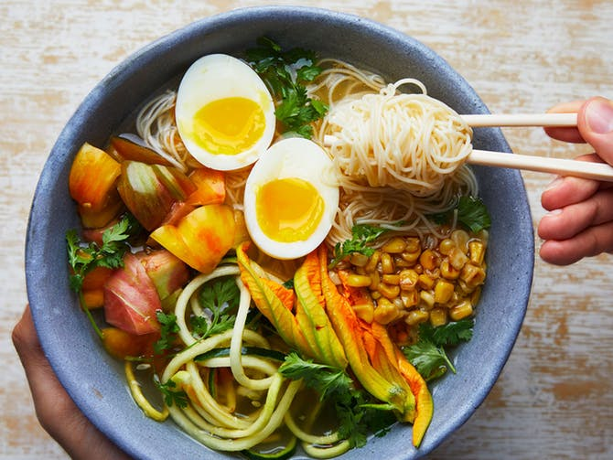

Ramen :P

Slide 6

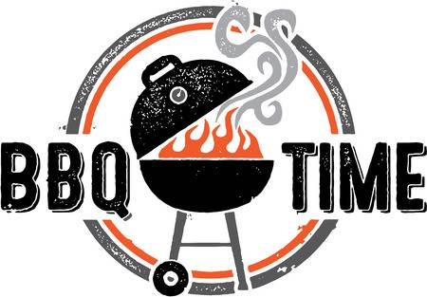
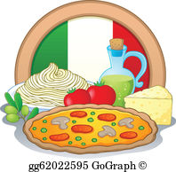
If you ever want to open restaurant in Tokyo…
Maybe Chinese food?
Ramen is a good idea!
Or a BBQ restaurant
Or something Italian?

Slide 7

Thank you for attention!

